Slide 1
A campaign to teach children about the law.
Run by
Sponsored by
Supported by
© Young Citizens

Slide 2
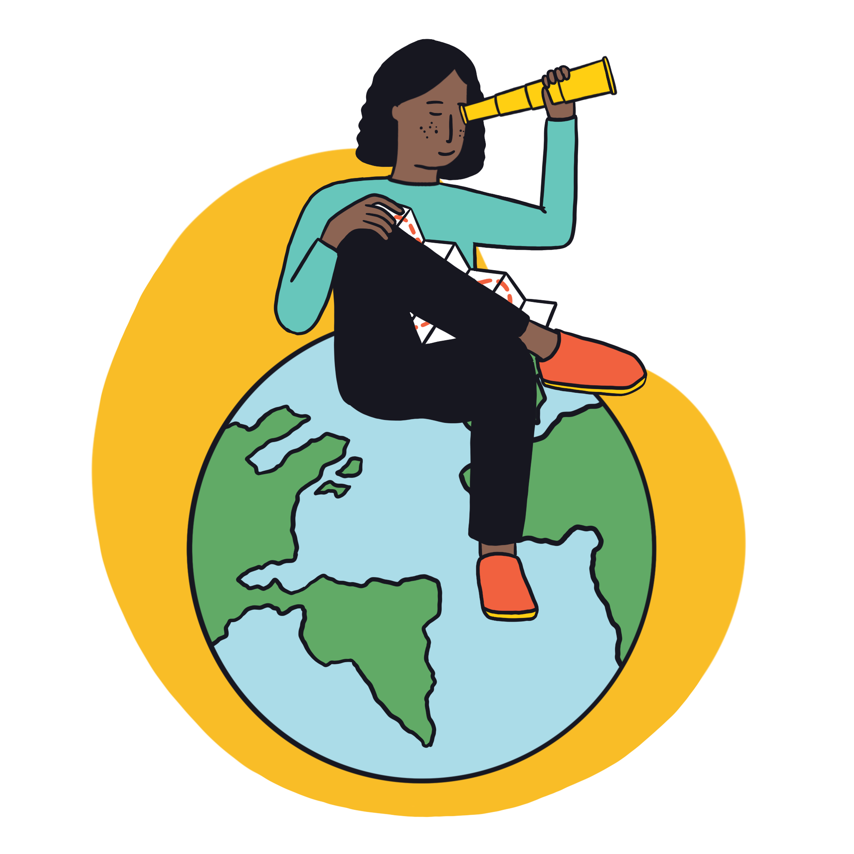
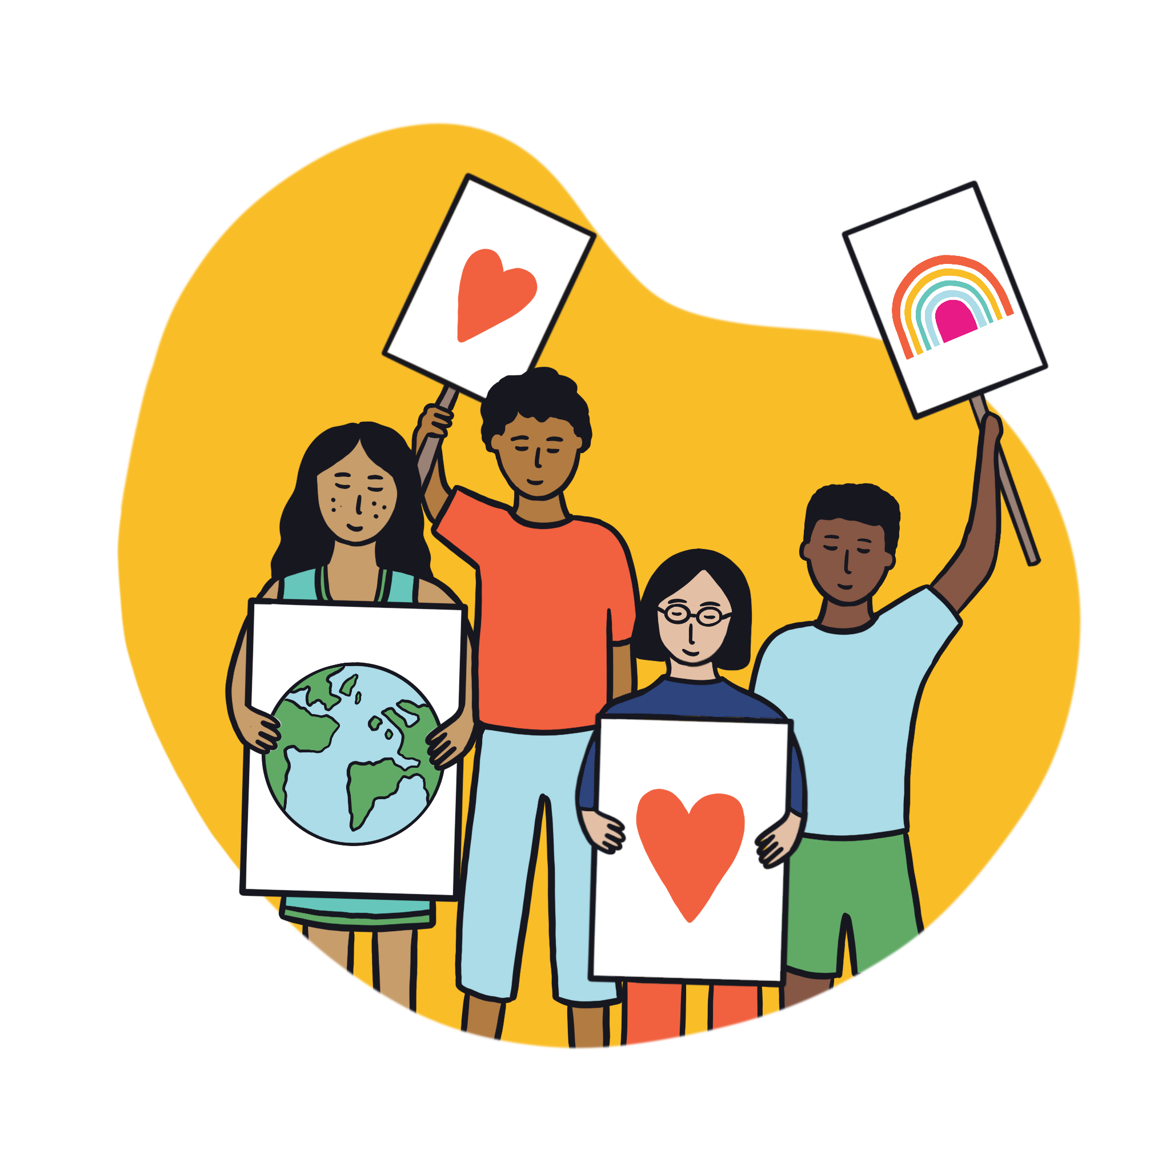
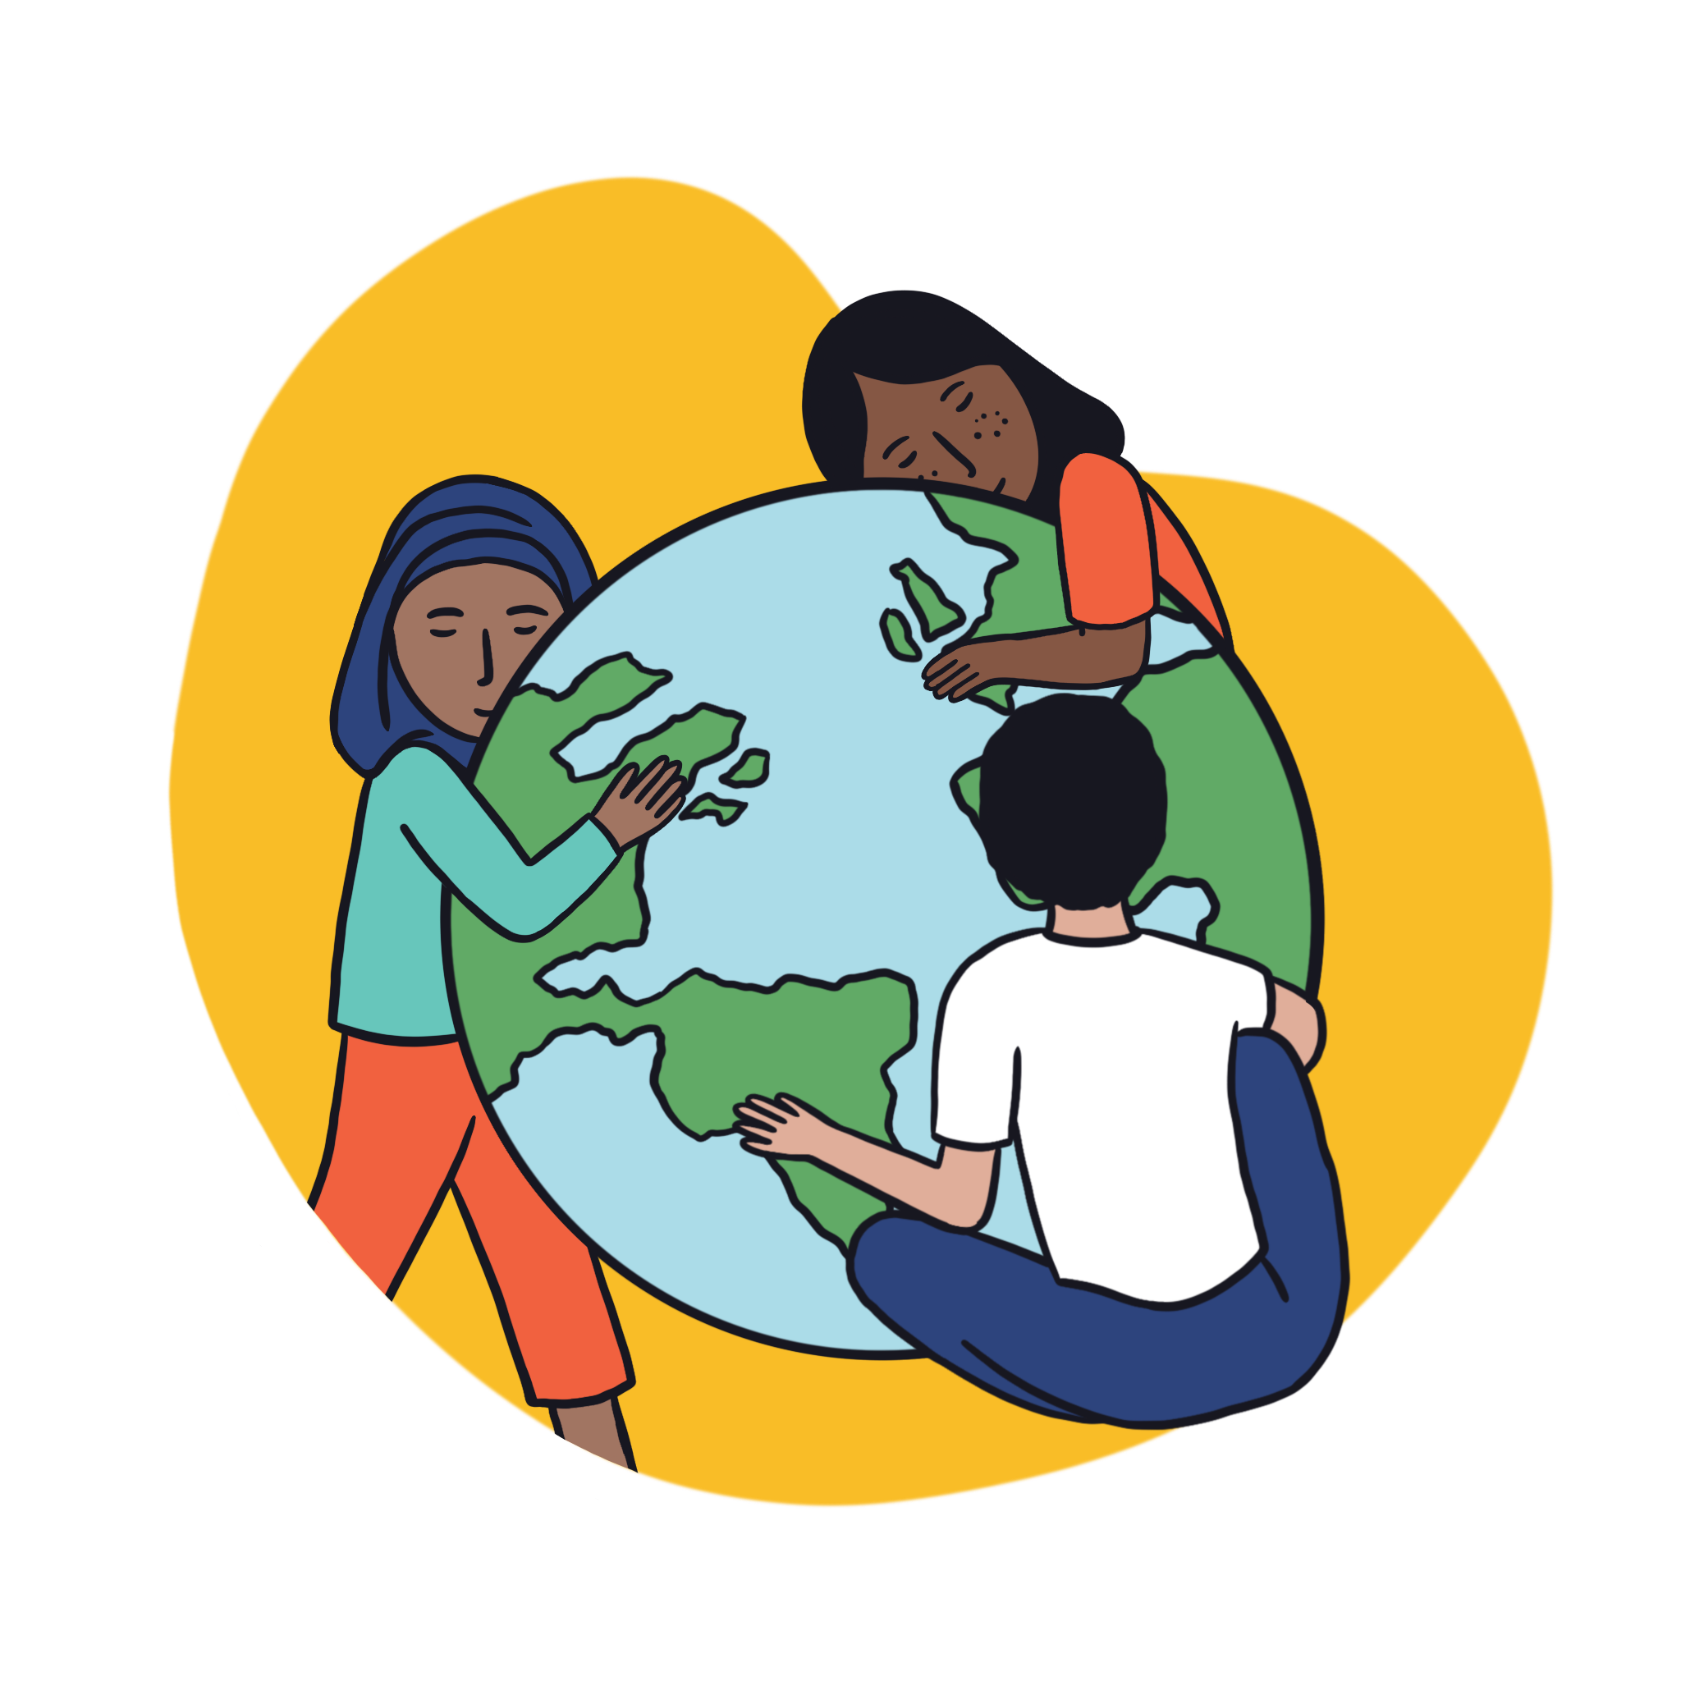
Young Citizens
Lighting the spark in children.
A charity working for a world where everyone can make a positive difference.
All children should leave school with the knowledge, skills and confidence to make their voices heard.
2
© Young Citizens
Notes:
We have a vision of a world where all people (no matter how young or old) can help shape their communities. A world where everyone has the knowledge, skills and confidence to make their voices heard, locally, nationally and globally.
Our mission is to provide learning experiences that light this spark in children and young people, a spark of active citizenship that grows as they do.
We work with schools, teachers, children and young people all over the UK. Each year 500,000 children and young people from over 6,000 schools benefit from our learning experiences.

Slide 3
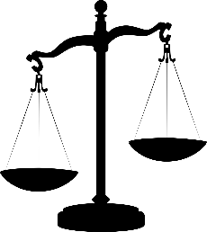
What’s that got to do with the law?
To make your voice heard, you need to know your rights and responsibilities.
We want to help you explore:
What the law is.
How the law affects your life.
Who makes the law.
How to get your opinions about the law heard.
3
© Young Citizens
Notes:
Our work helps children from an early age to shape their communities, institutions* and society, building habits for life.
A big part of this is supporting children to understand the systems and structures that exist within our society, teaching them how they can make their voices heard within these systems. This, of course, includes the legal system.
*Institutions – Organisations that have power. These include, political and parliamentary structures e.g. the legal and justice system.

Slide 4
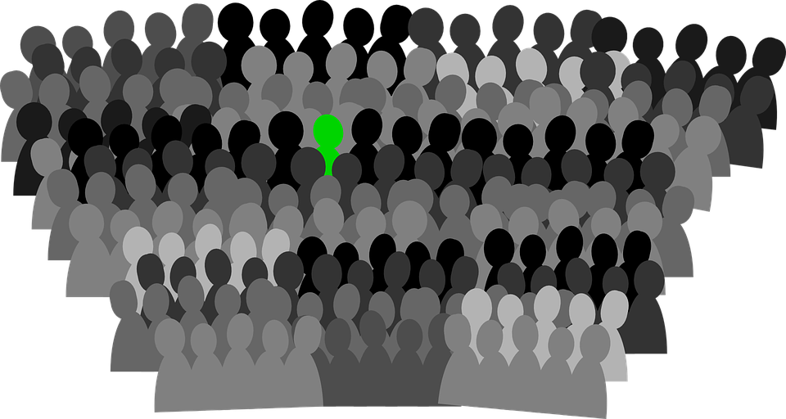
A national campaign to make sure everyone learns about the law at school.
Since 2020 over 150,000
young people from over
3,000 schools have taken part.
Now it’s your turn to get involved!
4
© Young Citizens
Notes:
150,000 young people – that’s more young people than could fit in Wembley stadium!

Slide 5
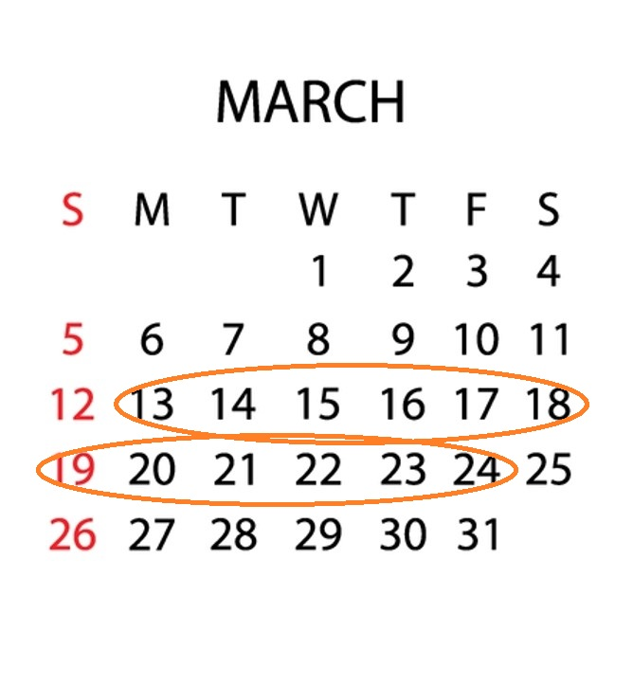
What will you be doing?
From 13th-24th March your school
will be taking part in the
Big Legal Lesson.
You will be …
School to insert details of planned activities …
Could include: Tutor time, PSHE/Citizenship activities etc
5
© Young Citizens
Notes:
Please edit this slide to describe what activities you have planned for the Big Legal Lesson.

Slide 6
What is the law?
How does the law affect my life?
Who makes the law?
What if I don’t agree with the law?
What are my rights?
How can I make my voice heard?
6
© Young Citizens
Notes:
Explain to pupils that the activities they will be taking part in during the Big Legal Lesson will help them to answer questions such as these.
You might like to ask them if they have any other questions that they’d like answering (e-mail us their suggestions which we can look to explore in future Big Legal Lesson resources – info@youngcitizens.org)

Slide 7
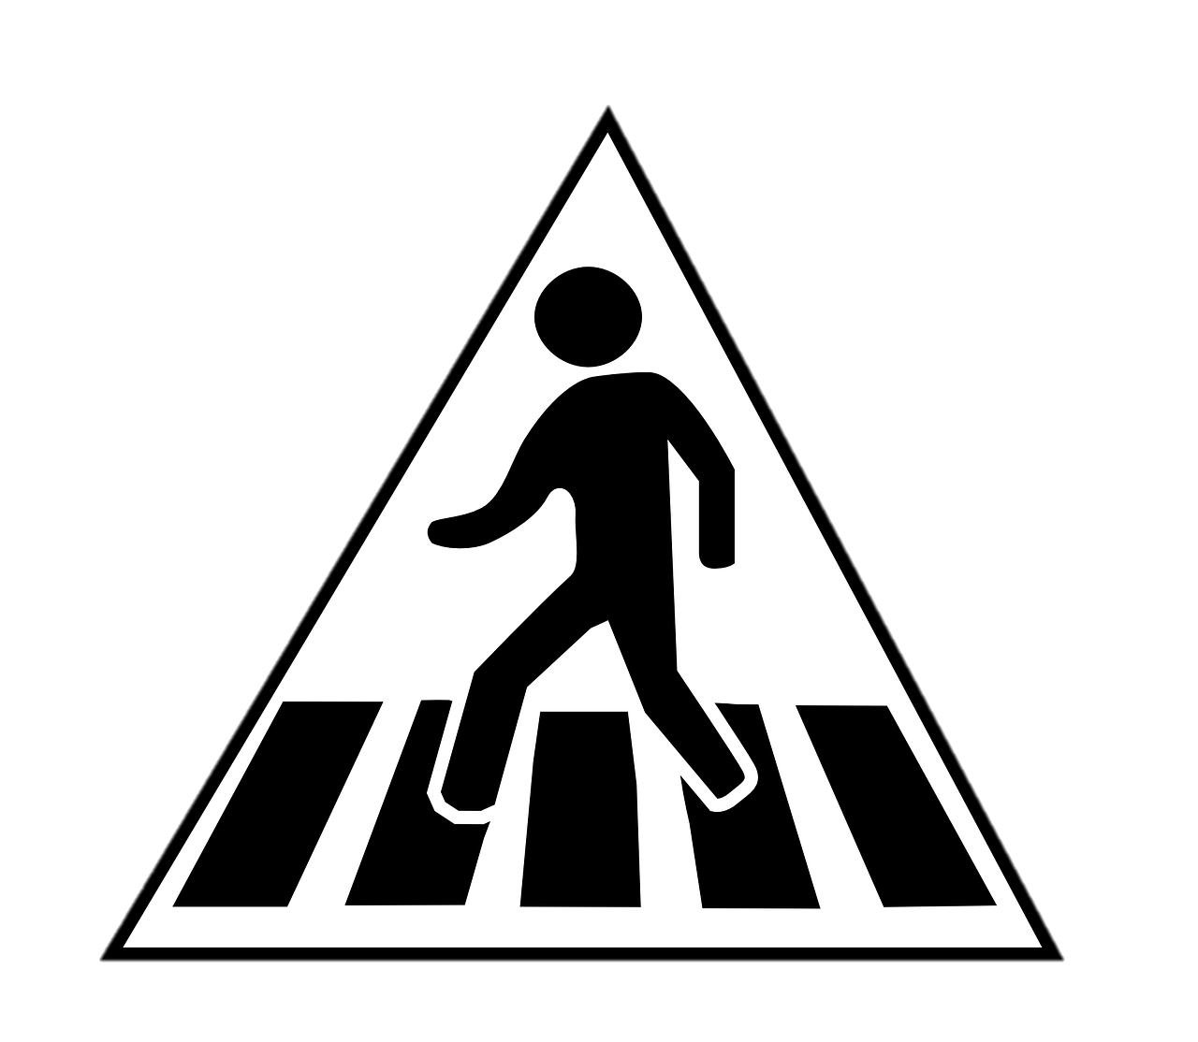
A little taster of what’s to come …
Hands up if you think this is against the law:
Dropping litter from a car window.
Getting a job when you are 11.
Cars not stopping at a zebra crossing
7
© Young Citizens
Notes:
Dropping litter from a car window
Under environmental law dropping litter is illegal. You could receive a fixed penalty fine.
Getting a job at 11
The youngest age a child can work part-time is 13, except children involved in areas like: television, theatre and modelling. Children working in these areas will need a performance licence.
Not stopping at a zebra crossing.
Under the Highway Code, traffic does not have to stop until someone has moved onto the crossing. Drivers and riders should give way to pedestrians waiting to cross and MUST give way to pedestrians on a zebra crossing.

Slide 8
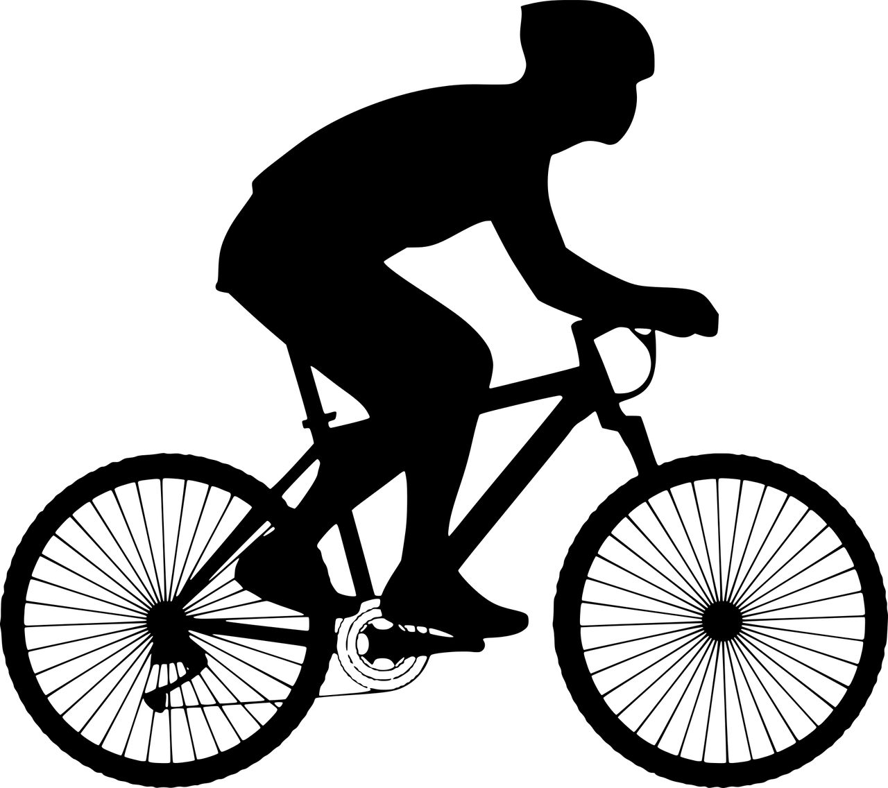
Hands up if you think this is against the law:
Cycling in the dark without lights on.
Not wearing a seatbelt.
Cycling through a red light.
8
© Young Citizens
Notes:
Cycling in the dark without lights on
It is against the law to cycle on a public road between sunset and sunrise without lights. You should have a white light on the front of your bike and a red light on the back of your bike. You should also have reflectors on the front and back of your bike.
Not wearing a seatbelt
The law says you must wear a seatbelt if one is fitted in the seat you are sitting in, there are very few exceptions to this. Drivers are responsible for ensuring any children are in an appropriate car seat for their height or weight. Children must remain in an appropriate car seat until they reach 135 centimetres tall or their 12th birthday, whichever is first. Drivers can be fined up to £500 if a child under 14 isn’t in the correct car seat or wearing a seatbelt.
Cycling through a red light
A red traffic light applies to all road users. Cyclists must not cross the stop line if the traffic lights are red. Being caught for this offence carries a fine.

Slide 9
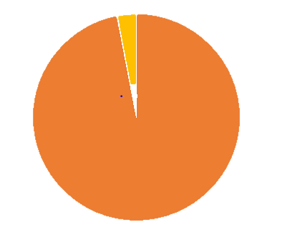
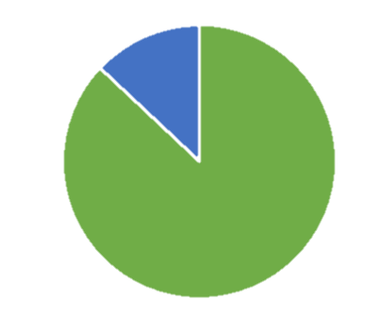
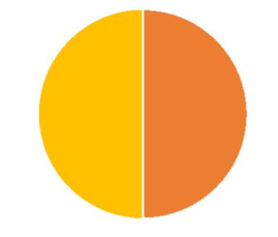
97% of children who take part in the Big Legal Lesson would recommend it.
87% feel more able to make a positive difference.
50% want their schools to run more lessons about the law.
9
© Young Citizens
Notes:
Some feedback from past participants

Slide 10
“Honestly, one of my favourite lessons of the year.”
“Now I understand more how things work …how and why laws are important and how it effects society. ”
“ It’s pitched just right … it’s engaging … the content
applies to me.”
10
© Young Citizens
Notes:
Some feedback from past participants

Slide 11
Tell us what you did
We’d love to hear about your activities and see pictures of your work. #TheBigLegalLesson
@YoungCitizensUk
info@youngcitizens.org
11
© Young Citizens
Notes:
Please do get in touch and tell us (and others) what you got up to during the Big Legal Lesson – we have a schools media pack to help!

